Slide 1
Introduction to Information and Communication Technologies
Lecture # 4
Department of Computer Science
CUI Lahore Campus
The slides are adapted from the publisher’s material
Understanding Computers: Today and Tomorrow (Ch2)
&
Computer Science Illuminated (Chapter 2)

Slide 2
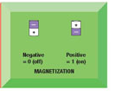
Data and Program Representation
Digital data representation: The process of representing data in digital form so it can be understood by a computer

Slide 3
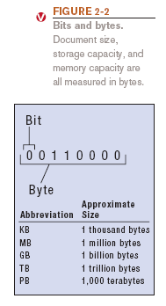
Digital Data Representation
Bit: The smallest unit of data that a computer can recognize (a single 1 or 0)
Byte = 8 bits
Byte terminology used to express the size of documents and other files, programs, etc.
Prefixes are often used to express larger quantities of bytes: kilobyte (KB), megabyte (MB), gigabyte (GB), terabyte (TB), etc.

Slide 4
The Number System
Digit: A single numerical symbol used to form numbers.
Or
It can be defined as: symbols to represent the magnitude of a quantity.
Example: 0,1,2,3,4,5,6,7,8,9
Number:A combination/collection of one or more digits that represent a value.
Example: 25 (formed using digits 2 and 5)
Numbering system: A way of representing numbers.
Each number system has:
A Base (Radix): Determines how many unique digits are used.
A Set of Digits: The symbols allowed in that system.
Place Value: Each digit’s position represents a power of the base.

Slide 5
Types of Number System
1. Decimal Number System (Base-10)
Used by humans in daily life.
Consists of 10 digits: 0, 1, 2, 3, 4, 5, 6, 7, 8, 9.

Slide 6
Positional Notation
Positional notation (or place-value system) is a method of representing numbers where the value of each digit depends on its position in the number.
The rightmost digit has the least value (least significant digit), and the leftmost has the highest value (most significant digit).
Each place value is a ”power of the base” (radix) of the number system.

Slide 7
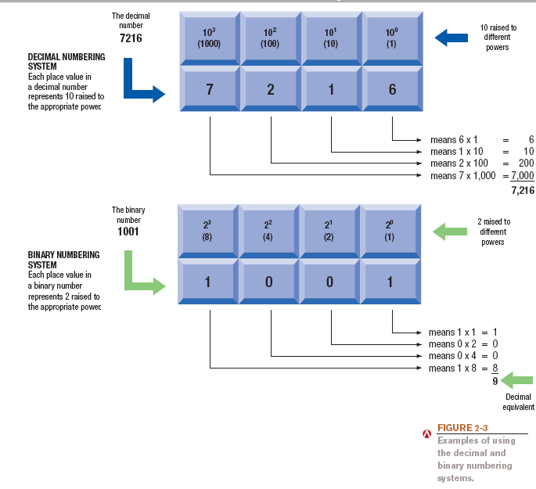
The Binary Numbering System

Slide 8
Positional Notation
Another EXAMPLE:
642 in base 10 positional notation is:
6 x 10² = 6 x 100 = 600
+ 4 x 10¹ = 4 x 10 = 40
+ 2 x 10º = 2 x 1 = 2 = 642 in base 10
The power indicates
the position of
the number
This number is in
base 10

Slide 9
Types of Number System
2-Binary Number System (Base-2)
Used by computers and digital circuits.
Consists of two digits: 0 and 1 (representing OFF and ON states).

Slide 10
Types of Number System
3. Octal Number System (Base-8)
Used in older computer systems and UNIX file permissions.
Consists of eight digits: 0, 1, 2, 3, 4, 5, 6, 7.

Slide 11
Types of Number System
4. Hexadecimal Number System (Base-16)
Used in computer memory addressing, color codes (e.g., #FF0000 for red)..
Consists of 16 symbols: 0-9 and A-F (where A=10, B=11, ..., F=15).

Slide 12
Why do we need different Number Systems?
Computers work in binary but humans use decimal, so conversion is needed.
2.Efficient data storage and processing (hexadecimal is compact for memory addressing).
3.Different number systems suit different applications (e.g., UNIX file permissions in octal).

Slide 13
Number system conversions
1- Decimal to Binary/Octal/Hexadecimal
2- Binary/Octal/Hexadecimal to Decimal
3- Between Binary/Octal/Hexadecimal

Slide 14
1-Decimal to Binary/Octal/Hexadecimal Converting Decimal to Binary
Example Scenario: A computer stores numbers in binary. If you enter 75 in a program, it must be converted into binary for processing.
Method: Repeated division by 2, recording the remainder each time.
Result: Read from bottom to top → 1001011₂
2 | 75
2 | 37 | 1
2 | 18 | 1
2 | 9 | 0
2 | 4 | 1
2 | 2 | 0
 | 1 | 0
75 = 1001011

Slide 15
Converting Decimal to Binary (Float)
What is the Binary equivalent of the decimal number 75.40?
2 | 75
2 | 37 | 1
2 | 18 | 1
2 | 9 | 0
2 | 4 | 1
2 | 2 | 0
 | 1 | 0
75 = 1001011
=0.40 x 2 = 0.8
=0.80 x 2 = 1.6
=0.60 x 2 = 1.2
=0.20 x 2 = 0.4
0.40 = 0110
Pick the Integer Part until term become 0 or for at least 4 terms
75.40 = (1001011.0110)

Slide 16
2- Binary/Octal/Hexadecimal to Decimal Converting Binary to Decimal
What is the decimal equivalent of the binary number 1101110?
1 x 2⁶ = 1 x 64 = 64
+ 1 x 2⁵ = 1 x 32 = 32
+ 0 x 2⁴ = 0 x 16 = 0
+ 1 x 2³ = 1 x 8 = 8
+ 1 x 2² = 1 x 4 = 4
+ 1 x 2¹ = 1 x 2 = 2
+ 0 x 2º = 0 x 1 = 0
= 110 in base 10

Slide 17
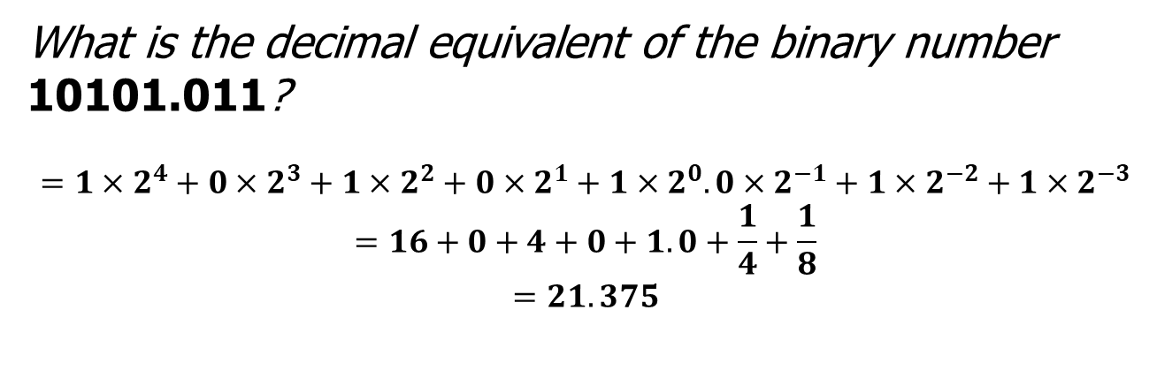
Converting Binary to Decimal (Float)
What is the decimal equivalent of the binary number 10101.011?
$$={1×2}^{4}+{0×2}^{3}+{1×2}^{2}+{0×2}^{1}+{1×2}^{0}.{0×2}^{−1}+{1×2}^{−2}+{1×2}^{−3}$$
$$=16+0+4+0+1. 0+\frac{1}{4}+\frac{1}{8}$$
$$=21. 375$$

Slide 18
Converting Octal to Decimal
What is the decimal equivalent of the octal number 642?
6 x 8² = 6 x 64 = 384
+ 4 x 8¹ = 4 x 8 = 32
+ 2 x 8º = 2 x 1 = 2
= 418 in base 10

Slide 19
Converting Hexadecimal to Decimal
What is the decimal equivalent of the hexadecimal number DEF?
D x 16² = 13 x 256 = 3328
+ E x 16¹ = 14 x 16 = 224
+ F x 16º = 15 x 1 = 15
= 3567 in base 10
Remember, the digit symbols in base 16 are 0,1,2,3,4,5,6,7,8,9,A,B,C,D,E,F

Slide 20
3- Conversion between Binary/Octal/Hexadecimal
1st step is to convert binary/octal/hexadecimal to Decimal
2nd step is to convert that decimal into binary/octal/hexadecimal

Slide 21
More Conversions
Decimal to Binary
Decimal to Hexadecimal
Decimal to Octal
Binary to Decimal
Binary to Hexadecimal
Binary to Octal
Octal to Binary
Octal to Decimal
Octal to Hexadecimal
Hexadecimal to Binary
Hexadecimal to Decimal
Hexadecimal to Octal
HW: Practice examples of above scenarios

